Slide 1
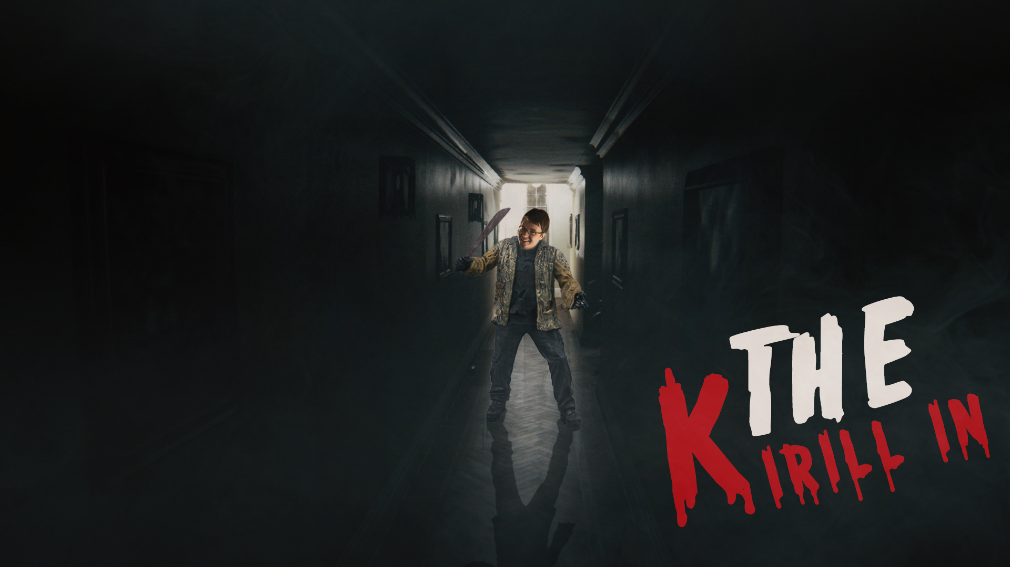
TEAM 4
Korab, Georgi, Sofoklis, Jack, Joe, Mariana, Gareth, Euan
Notes:
Person 1 – The aim of the game is for you, the player, to stop the Kirilling. This is where everything turns into Kirill through having Kirills DNA enter their body, it is a very deadly virus that must be stopped by you.

Slide 2
Game Concept
Our idea for this game is based on upon a classic horror game setting, post apocalypse asylum in the middle of nowhere. Although as you work through the game, your character comes to discover that they are infected with the Kirill virus, which turns anything living into a deadly Kirill.
So it then becomes a race to travel the map to find items that can be used to create a serum that will save you from the deadly Kirill Virus
Notes:
Our idea is based on a character discovering and trying to defeat a deadly virus called the Kirill virus. This is a virus that causes

Slide 3
The creation of the game
We began the creation process with a group meeting where we brainstormed
ideas and discovered the key features we wanted to include in the game. This
Included ideas such as puzzles and NPCs.
Once we had our base idea, we created a map to try and visualize how the game
Would be laid out and ensure that the layout would make sense.
After this we moved onto finishing the story and writing all the descriptions that
would be printed when you enter each room.

Slide 4
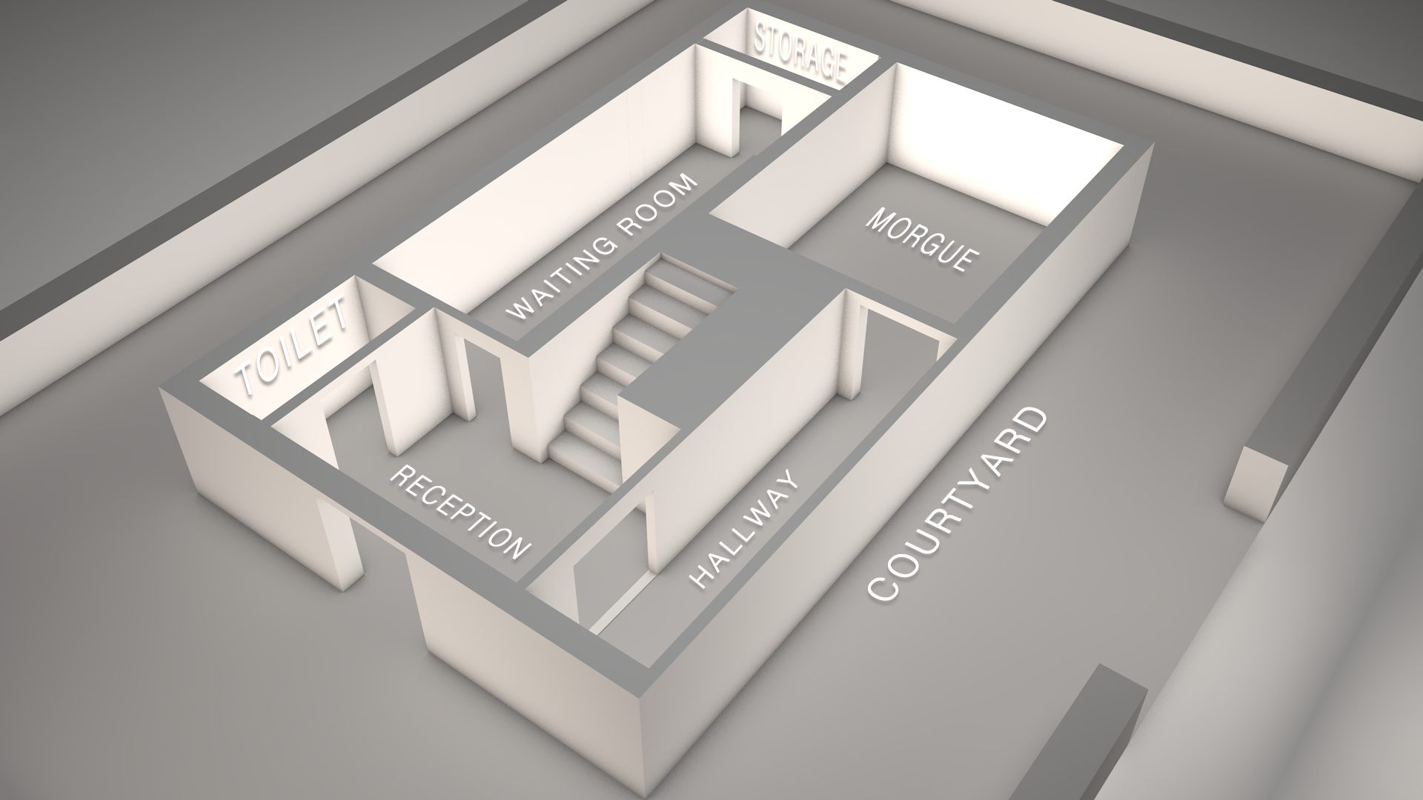
Map
Our map is only based on the ground floor of an asylum and includes the following rooms:
Reception
Toilet
Waiting Room
Storage Room
Hallway
Morgue
Courtyard
Your character will begin the game in the Courtyard, as story begins with you driving up to the asylum.
Each room contains a group of items, as well as a hint to find a key or ID card to let you into the next room.

Slide 5
Objective
The main object of the game is to find the items that will be used to create a serum to save you from the Kirill virus. These items can be found in different rooms and all must be collected in order to finish the game.
At the beginning of the game your character is not aware of the Kirill virus so the objective at the start is to explore the building and find information.
Notes:
Person 2 – The only way to beat the game is to create a serum that can be made using the items that are spread out across the map, some of these items can be combined to make a new item that is used to create the serum. There are multiple steps that you need to do for you to create the serum, not just 1 or 2.
Person 2 – This map is located at an asylum where the Kirilling originated, from here you will be able to find the first thing that turned into Kirill and use its DNA to create a serum.

Slide 6
Features
Ascii Art – We wanted to include some ascii art as we believe it's important to make games visual and a text based game can be limiting.
Notes:
Person 2 – There is ASCII art in the game, this art will appear throughout the game and will come in different shapes and sizes.
Person 2 – There are hints spread across the map that will tell you what you need to do to create the serum to the virus, these hints will not tell you everything you need to do and will only be light hints so the game isn’t going to be super easy to complete by just using the hints.

Slide 7
Video

